Slide 1
Feudalism, Absolutism
&
Government Systems

Slide 2
Feudalism
Feudalism- (Fyoo-duh-lih-zuhm) A system of PROTECTION in the Middle Ages.
Vassal- An oath of loyalty between knights and lords that stated they would protect the land.
Knight-a vassal (loyal subject) for his lord
Lord- a vassal for a king.

Slide 3
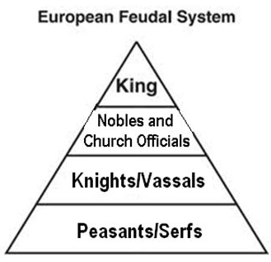
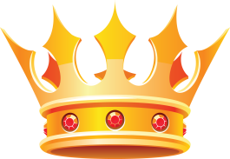
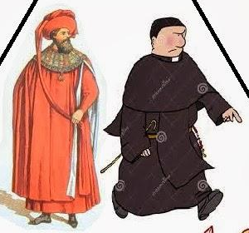
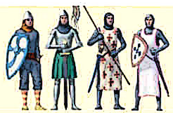
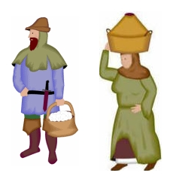
COPY THIS CHART IN YOUR NOTES

Slide 4
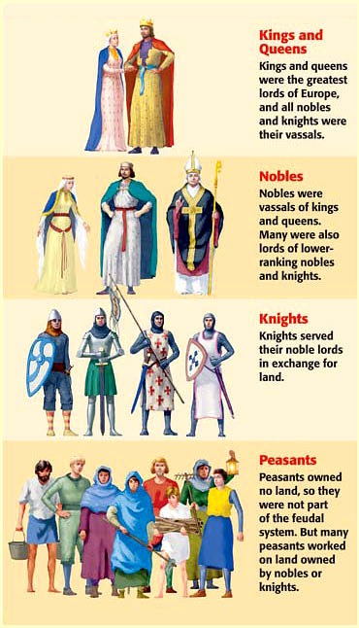
Kings
Kings gave land to the lords.
All lords/nobles and knights swore an oath of loyalty to protect the king’s land.

Slide 5
Nobles/Lords
Swore loyalty to the king.
In exchange, nobles were given land called fiefs to protect.

Slide 6
Knights
Armored warriors that protected their lords’ land.
They often received fiefs (land) for their service.

Slide 7
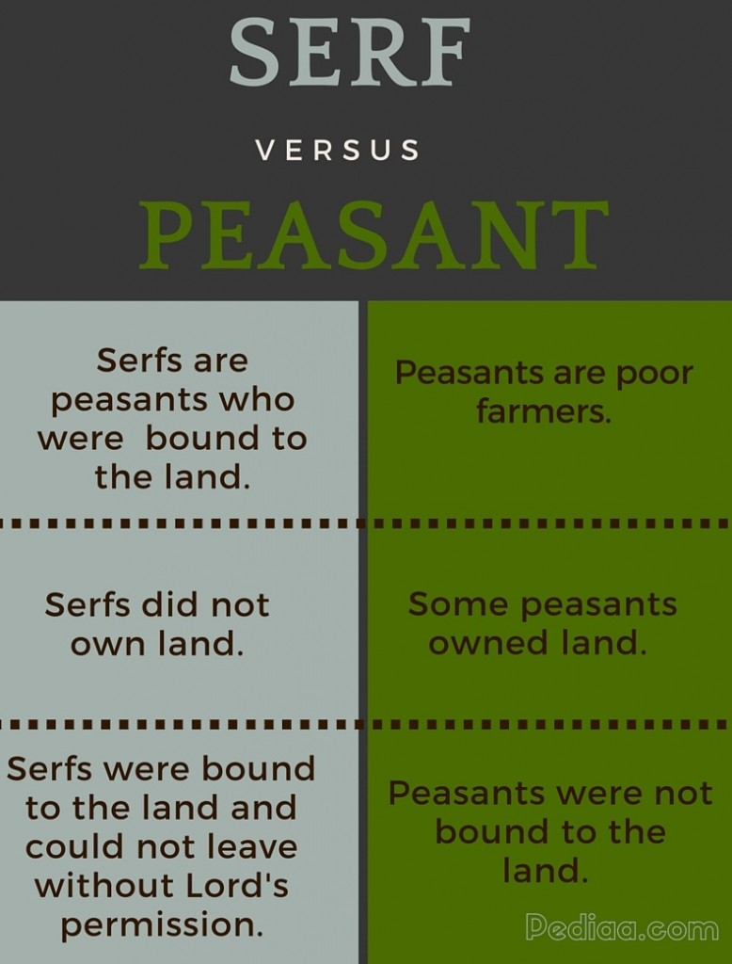
Peasants/Serfs
Worked on the lords land (manors) growing and harvesting food for the feudal system.
Received protection for their service.

Slide 8
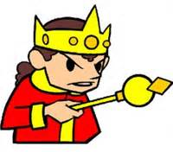
Absolutism
In 17th Century Europe, absolutism was tied to the idea of the divine right of kings
Absolute monarchy – a form of government where a single ruler, usually a king, has complete control over all parts of the government. Their power is not limited by a constitution or by the law. ... The king has the power to do whatever he wants!
Divine right - a monarch (king) is not subject to any rule on earth and his right to rule comes directly from God. Kings used divine right to justify their power.

Slide 9
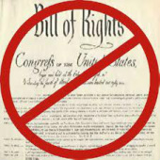
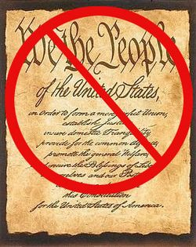
Power of an absolute monarch
Most people did not have any rights at all
No written Constitution or Bill of Rights (These are meant to limit government power and give rights to citizens)
Absolute monarchs had tremendous powers
  Make laws
  Levy taxes
  Administer justice
  Control the state’s officials
  Determine foreign policy

Slide 10
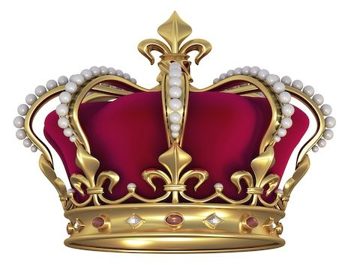
King Louis XIV (1643-1715)
France had a monarchy, which means that they were ruled by a King/Queen.
However, the type of monarchy they had was an absolute monarchy.

Slide 11
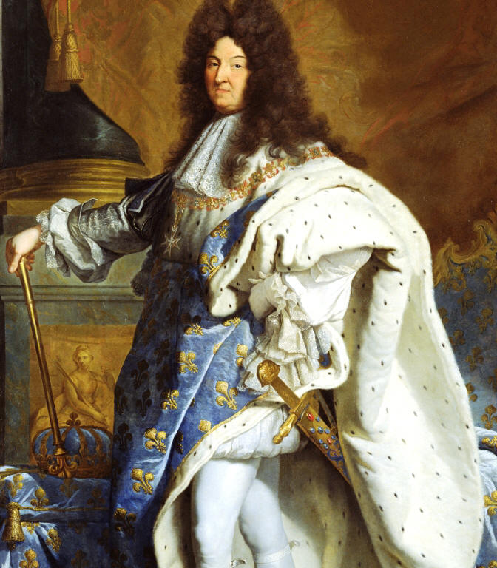
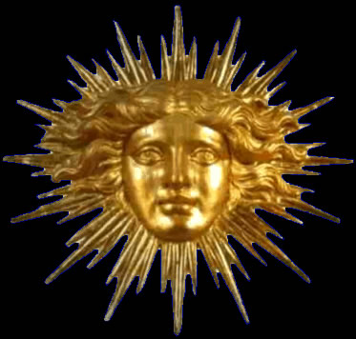
King Louis XIV
Louis XIV was considered an absolute ruler. He was only accountable to God for his actions.
Known as a king of luxury and extravagance
He was known as the Sun King because of the idea that “As the planets revolve around the Sun, so too should France and the court revolve around him.”

Slide 12
The Palace of Versailles
Louis XIV spared no expense to make this the most magnificent building in Europe
Was the perfect symbol of the Sun King’s wealth and power
Served as the Louis XIV’s home and the seat of the government
700 rooms, 67 staircases, 200 windows
Louis XIV spent a lot of the taxpayer’s money on the palace of Versailles and wars. France was bankrupt! The people of France were not happy.

Slide 13
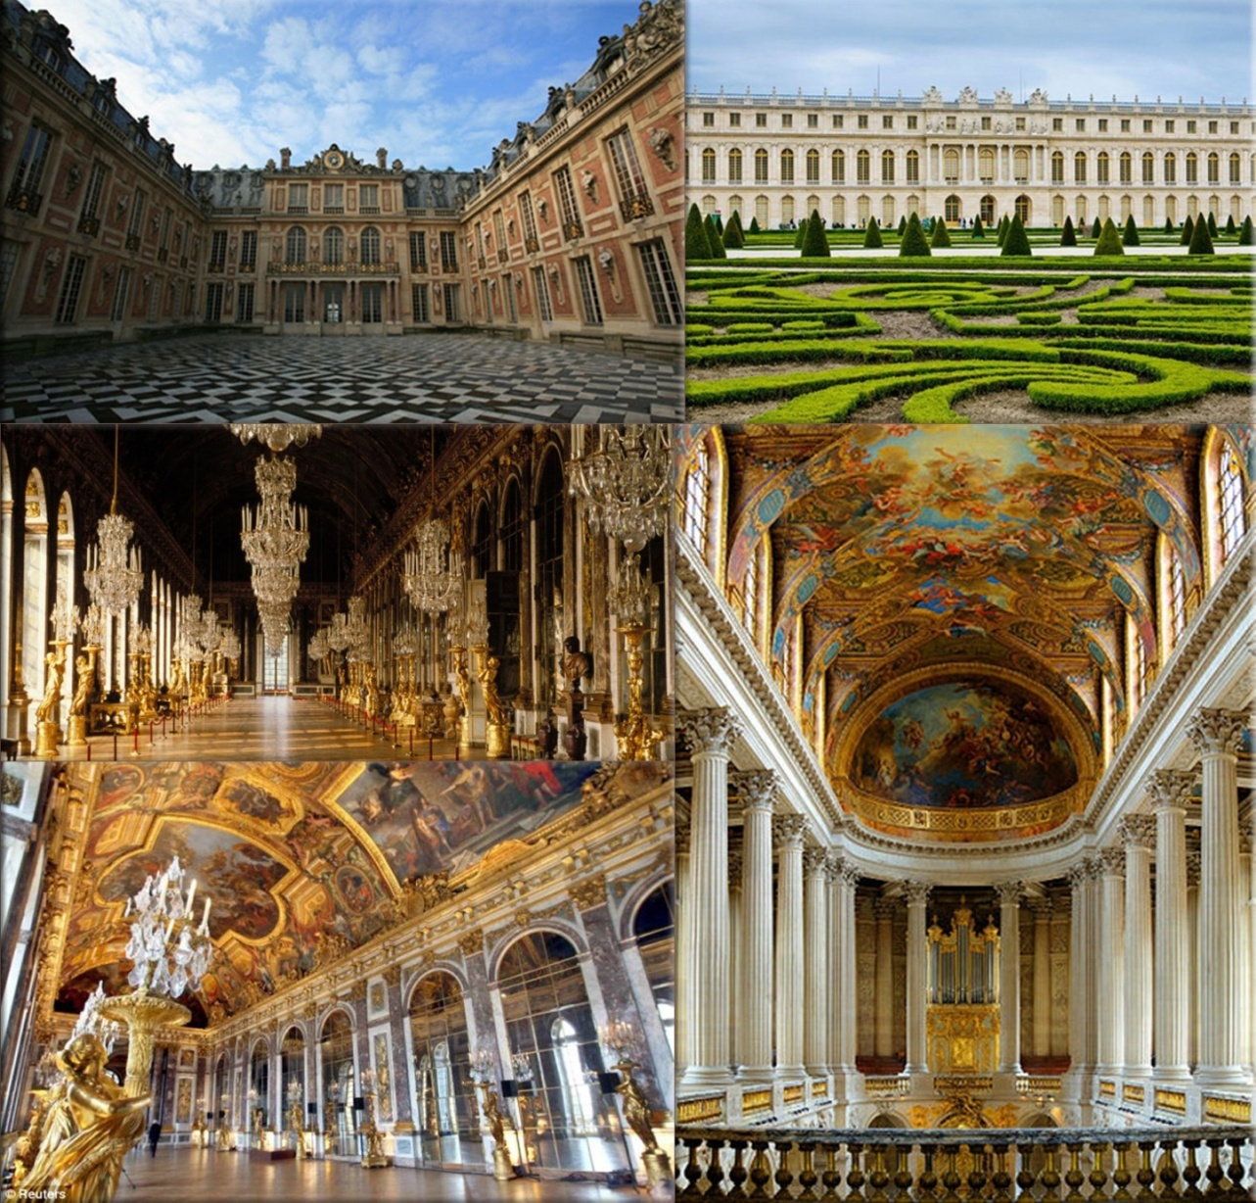
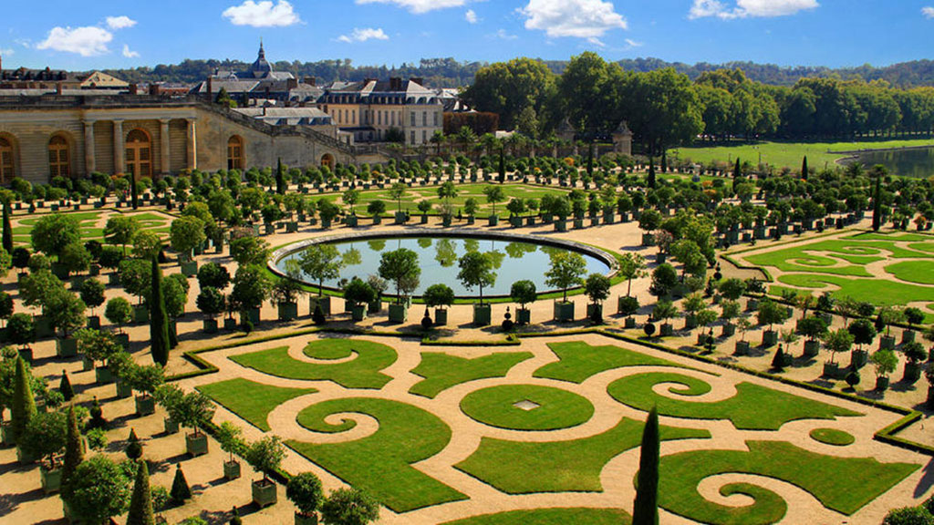
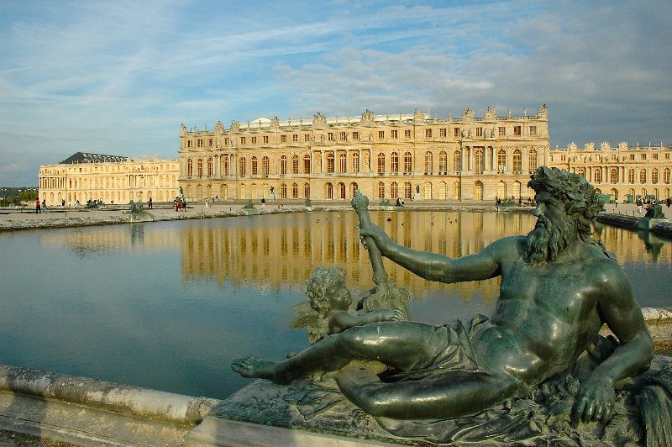

Slide 14
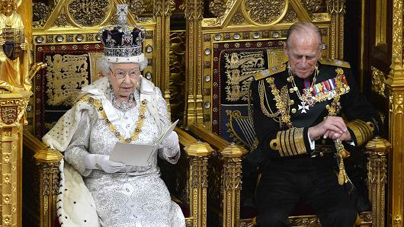
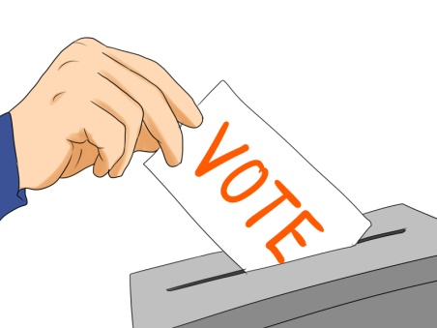

Types of Government
Monarchy:
  State ruled by a king
  Rule is hereditary (passed down from one member of a family to another member)
  Claim divine right
Democracy
  State ruled by its citizens
  Rule is based on citizenship
  Majority rule decides vote
Theocracy
  Government based on religious law.
  Heads of government are religious leaders

